Slide 1
Aggressive Mustard Rebellion
By:
Michael Kuzminsky, David Hunter, Ross Bunker, Hunter Lang and Matt Bailey

Slide 2
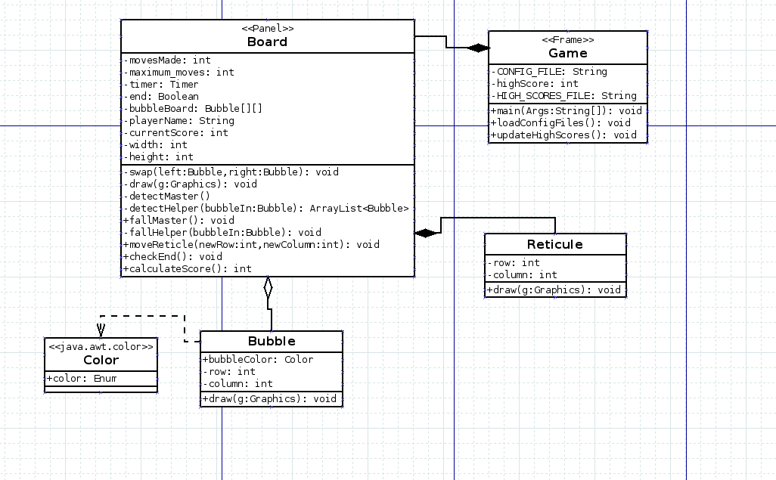
UML

Slide 3
Things We Learned
How to get input from the Keyboard through the GUI
Usefulness of everything drawing itself
Importance of using tests to test functionality
Importance of breaking up functionality and simplifying functions and classes
How awesome auto-generation is

